Slide 1

Learning Computational Thinking through the Bebras Contest
Valentina Dagienė
Vilnius Lithuania

Slide 2
Items discussed in the workshop
About the Bebras
Operational definition of Computational Thinking
Why Bebras tasks can convey Computational Thinking?
Which concepts of informatics can be introduced through Bebras tasks?
How to teach computational thinking using Bebras tasks?
Teachers’ constructionist and deconstructionist learning by using Bebras tasks

Slide 3
International Contest on Informatics and Computational Thinking BEBRAS (Lithuanian word for beaver)
Goals
to develop Computational Thinking
to stimulate pupils’ interest in informatics and information technology
to encourage pupils to think deeper while using computers and information technologies
to inseminate concepts of informatics

Slide 4
Participants
all pupils age 8 to 19
different tasks for 5 age groups:
PRIMARY 8-9 years (grade 3-4)
BENJAMIN 10-12 years (grade 5-6)
KADETS 13-14 years (grade 7-8)
JUNIOR 15-16 years (grade 9-10)
SENIOR 17-19 years (grade 11-13)
Tasks
pupils have to solve 15-24 tasks within 40 to 60 minutes
interactive tasks, open ended and multiple-choice tasks
2 - 4 minutes per task
easy, medium and hard tasks
performed on PCs, usually during school lectures

Slide 5
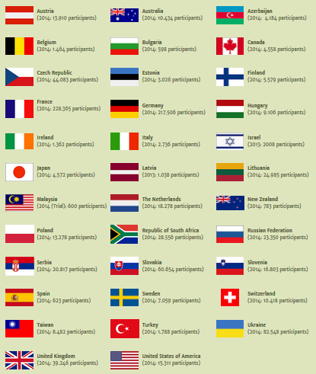
35 countries in 2014

Slide 6
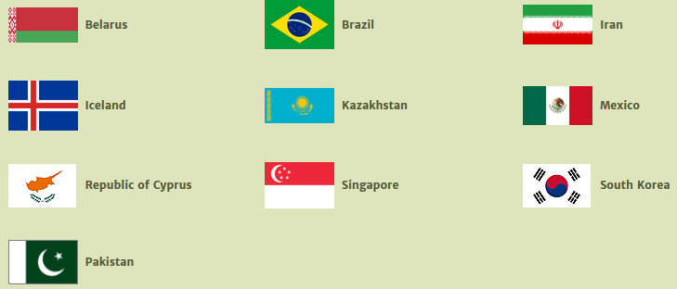
Countries are planning to join the Bebras

Slide 7
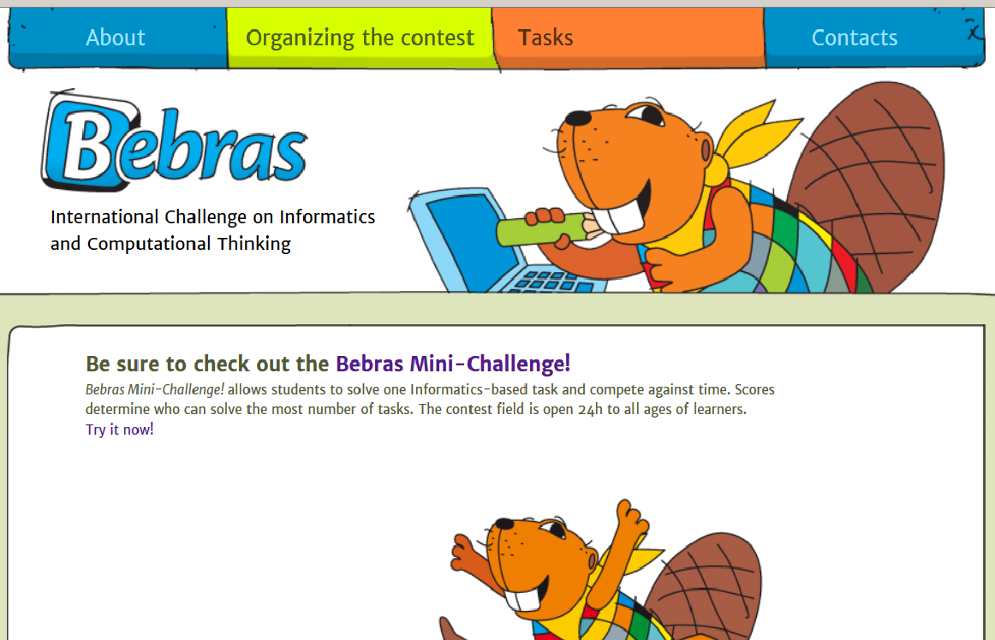
http://bebras.org

Slide 8

http://bebras.di.unimi.it

Slide 9
Participants 2011-2014

Slide 10
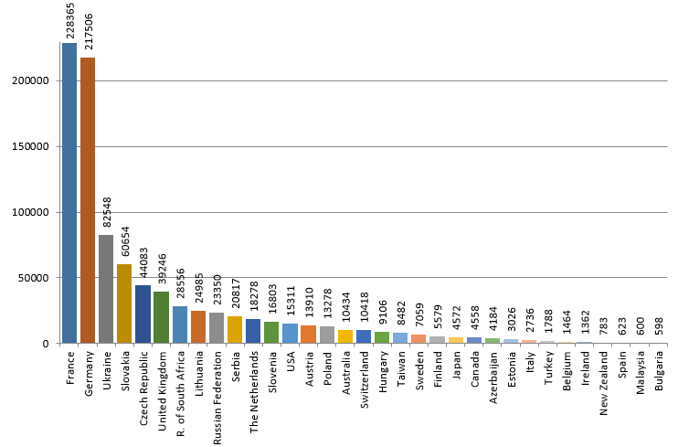
More than 925000 participants in 2014

Slide 11
About 45 % girls
Country | Students | Boys (%) | Girls (%) | Country | Students | Boys (%) | Girls (%)
Austria | 13 910 | 41,73 | 37,03 | R. of South Africa | 28 556 | - | -
Australia | 10 434 | 49,76 | 37,77 | Russia | 23 350 | - | -
Azerbaijan | 4 184 | - | - | Serbia | 20 817 | 58,63 | 41,37
Belgium | 1 464 | 66,32 | 33,68 | Slovakia | 60 654 | 55,8 | 44,2
Bulgaria | 598 | 67,56 | 32,44 | Slovenia | 16 803 | 58 | 42
Canada | 4 558 | 66,37 | 33,63 | Spain | 623
Czech R. | 44 083 | 55,55 | 44,45 | Sweden | 7 059 | 56 | 44
Estonia | 3 026 | - | - | Switzerland | 10 418
Finland | 5 579 | 58,24 | 41,76 | Taiwan | 8 482 | 48,83 | 51,17
France | 228 365 | 51,2 | 48,8 | The Netherlands | 18 278 | 59,5 | 40,5
Germany | 217 506 | 56,7 | 43,3 | New Zealand | 783 | - | -
Hungary | 9 106 | 52,7 | 47,3 | Poland | 13 278 | - | -
Italy | 2 736 | - |  | Turkey | 1 788 | 52,96 | 47,04
Japan | 4 572 | 58,03 | 41,97 | Ukraine | 82 548 | 51,9 | 48,1
Lithuania | 24 985 | 57,74 | 42,26 | United Kingdom | 39 246
Malaysia | 600 | 45,67 | 54,33 | United States of America | 15 311 | 61 | 39

Slide 12
Bebras Contest:
The Challenge of Thinking
To solve the tasks one has to think
Already learned knowledge is not asked
Pupils have to find solving strategies
They have to find and understand structures
They have to find arguments for or against given alternatives

Slide 13
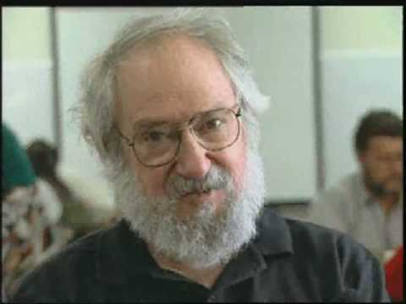

Computational Thinking
Originally used by Seymour Papert, MIT, in Mindstorms: Children, computers, and powerful ideas, Basic Books Inc. 1980.
Popularized by Jeanette M. Wing (2006) Computational Thinking. Communications of the ACM, 49(3), 33-35.

Slide 14

Computational Thinking
"Computational Thinking is the thought processes involved in formulating problems and their solutions so that the solutions are represented in a form that can be effectively carried out by an information-processing agent.“
Jan Cuny, Larry Snyder, and Jeannette M. Wing, “Demystifying Computational Thinking for Non-Computer Scientists,” 2010
Jeanette M. Wing
Carnegie Mellon University

Slide 15
Computational Thinking operational definition for K-12 education
Computational thinking (CT) is a problem-solving process
that includes (but is not limited to) the following characteristics:
Formulating problems in a way that enables us to use a computer and other tools to help solve them
Logically organizing and analyzing data
Representing data through abstractions such as models and simulations
Automating solutions through algorithmic thinking (a series of ordered steps)
Identifying, analyzing, and implementing possible solutions with the goal of achieving the most efficient and effective combination of steps and resources
Generalizing and transferring this problem solving process to a wide variety of problems
ISTE and CSTA, 2011

Slide 16
Formulating problems in a way that enables us to use a computer and other tools to help solve them

Slide 17

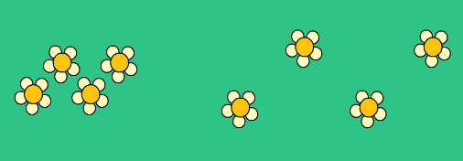

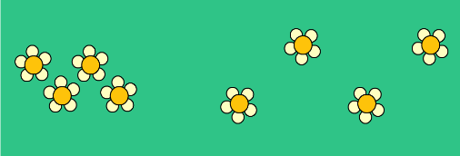

Planting Flowers
2012-DE-05, cadetts
A big beaver and a little beaver are planting flowers in the garden. The little beaver has smaller arms and smaller legs than the big beaver. Little beaver's steps are therefore shorter and it plants the flowers at positions closer to its body.
At the beginning, they stand on the lawn back to back looking in opposite directions. Then both move according to these instructions:
repeat twice:
plant a flower on your right hand side
move one step forward
plant a flower on your left hand side
move one step forward.
How does the lawn look like afterwards?

Slide 18
Logically organizing and analyzing data

Slide 19

Which Foto do you want?
2014-JP-03
Johnny has 8 photos. He would like to give one of them to Bella. He asks her some questions to find out which photo she wants:
“Do you want a photo with a beach umbrella?” “Yes.”
“Do you want a photo where I have something on my head?” “No.”
“Do you want a photo where you can see the sea?” “Yes.”
Which photo should Johnny give to Bella?
A) | B) | C) | D)
E) | F) | G) | H)

Slide 20
Representing data through abstractions such as models and simulations

Slide 21
Graph of a map
2010-AT-06
Maps can be easily pictured as graphs. In such a graph every node is a country and the lines between the nodes mean that they border each other. The picture shows a graph of a map with seven countries.
Indicate the map that fits the given graph

Slide 22
Automating solutions through algorithmic thinking (a series of ordered steps)

Slide 23
Dice
2013-SK-09, Junior
We have three commands draw-1, draw-2a and draw-2b that draw dots like this:
The command turn90 turns the pattern 90 degree.
For example the command sequence
draw-1,draw-2a,turn90 draws
Which sequence of commands draws this?
A) draw-2b, turn90 , draw-2a, draw-1
B) draw-2b, draw-2a, turn90 , draw-2a
C) draw-2a, draw-2b, turn90 , draw-2a
D) draw-2a, turn90 , draw-2a, draw-2b
draw-1 draw-2a draw-2b

Slide 24
Identifying, analyzing, and implementing possible solutions with the goal of achieving the most efficient and effective combination of steps and resources

Slide 25
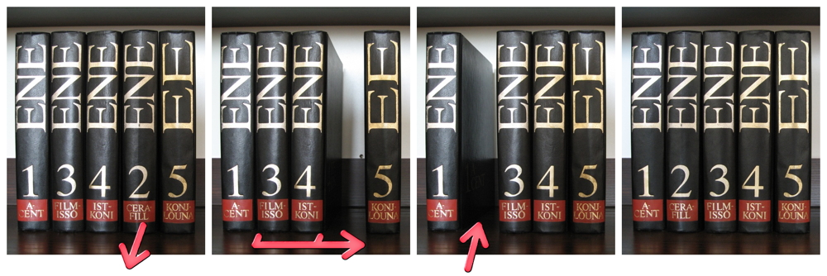
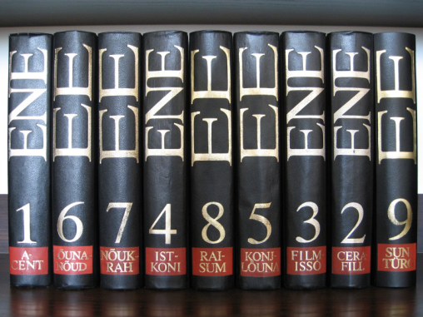
Bookshelf (Junior medium)
2010-EE-03
The librarian wants to order the volumes of an encyclopaedia with as few steps as possible.
For doing one step he takes a volume out of the shelf, shifts some of the remaining ones to left or right and puts the volume in his hand to the new free space.
The following example sorts 5 volumes using just one step:
Now he wants to order the following 9 volumes:
What is the smallest number of steps to order all 9 volumes?
This is computational thinking
A largest increasing subsequence remains untouched in the optimal solution. To find substructures that remain invariant is a key competence of computational thinking.

Slide 26
Generalizing and transferring this problem solving process to a wide variety of problems

Slide 27
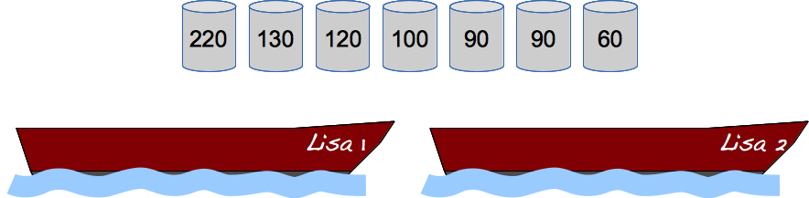
Loading Lisas
2014-DE-08, Benjamin to Junior
The fishermen Falke and Folke own two boats, named "Lisa 1" and "Lisa 2" – the two Lisas. The maximum load for each boat is 300 kilo.
Falke and Folke should carry some barrels filled with different kinds of fish. They are paid per kilo transported.
Put barrels onto the boats such that each boat gets loaded with as many kilos of fish as possible.
The barrels have their weight (in kilos) printed on them.

Slide 28
Constructivism & Constructionism
Constructivism is the process whereby students constructed their own unique systems of knowing
Constructionism symbolised a way of thinking about learning
  Building a model
  Reflecting on it
  Debugging
  Sharing
Seymour Papert expanded Constructionism in terms of helping the student produce constructions that others can see and critique
Constructivism is more cognitive
Constructionism more physical

Slide 29
Deconstructivism & Deconstructionism
The process of learning through construction can be split in two phase:
  Deconstruction
  and Construction
Third phase: creating new knowledge by re-ranging the components in another way
Deconstructivism is about the mental private decomposition of ideas and relations
Deconstructionism is about the deconstruction of tangible artefacts or about the public deconstruction of a concept

Slide 30
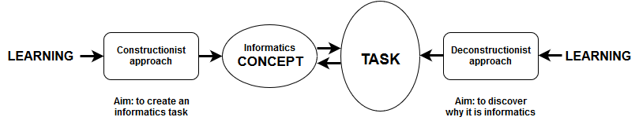
Teachers’ constructionist & deconstructionist learning by using Bebras tasks

Slide 31
How to work now
Work in groups of 2 or 3
Chose a task from the Bebras task set: you have tasks in English and Italian
Start with deconstructionist approach
Read a task
Discuss and find main concepts of Informatics
Try to formulate why it is Informatics
Read another task
Present your group reasoning

Slide 32
References
P. Boytchev (2015) Constructionism and Deconstructionism. Constructivist Foundations, 10(3), 355-361.
V. Dagiene, G. Futschek (2008) Bebras International Contest on Informatics and Computer Literacy: Criteria for Good Tasks, LNCS 5090, 19-30
V. Dagiene, G. Futschek (2010) Introducing informatics concepts through a contest. IFIP Working Conference: New Developments in ICT and Education, Amiens; Paper No 7, 15 pages.
G. Futschek, V. Dagiene (2009) A Contest on Informatics and Computer Fluency Attracts School Students to Learn Basic Technology Concepts, Proceedings 9th WCCE, Paper No 120.
Thanks!
International website
www.bebras.org

Slide 33

Thanks!
International website
www.bebras.org

