Slide 1
Origami Algorithms
Carol Yarbrough
Alabama School of Fine Arts
CS4Alabama

Slide 2
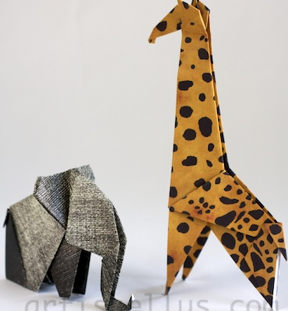
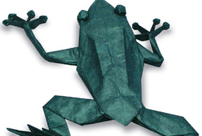
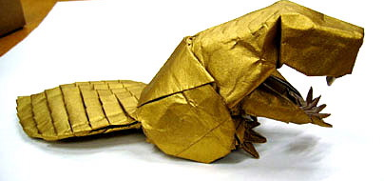
Introduction:
Have you ever made an origami animal?
A frog?
How?

Slide 3
Create from Pictures:
Using one sheet of the origami paper you have, create the animal from the pictorial instructions you were given.
Your friend will be creating a different animal.
Don’t Peek!!!
Don’t tell!!!

Slide 4
Discussion:
Was it easy to make your animal?
Were your instructions detailed enough?
What is missing?

Slide 5
Write Detailed Instructions:
Write instructions in words, to create your origami animal.
You can not use any pictures or diagrams.
Be exact and detailed.
You should work alone to complete this activity.

Slide 6
Create From Friend’s Instructions
Swap instructions with your partner (who has the other animal)
Create the animal using their instructions
What is it???

Slide 7
Group 1: Make a frog

Slide 8
Group 2: Make a dog
http://www.origami-fun.com/origami-talking-dog.html

Slide 9
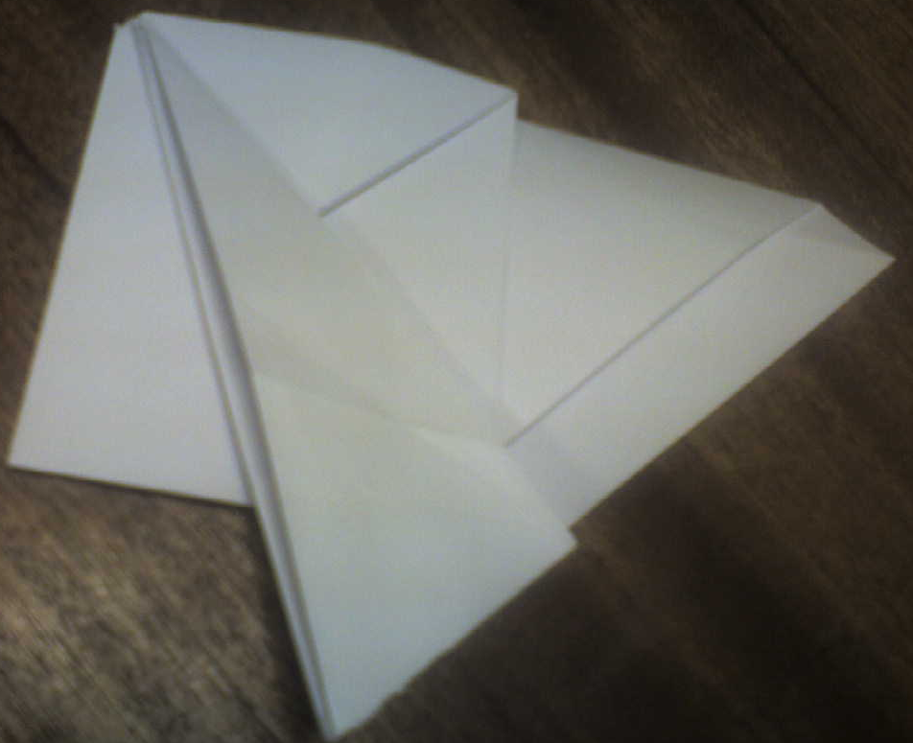
How did yours turn out?

Slide 10
Discuss Need for a Common Language:
Was it easy to create an animal from your classmate’s instructions?
What would make it easier?
A common language?

Slide 11
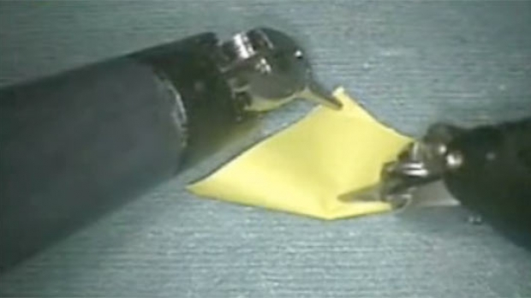
Develop a Common Language:
Instructions to give a paper folding robot

Slide 12
Our set of commands:
Notes:
Should include commands such as Right fold, Left fold, Valley fold, Mountain fold, Unfold, Rotate left x°, Rotate right x°, Turn over, Crease, etc.
Allow students to develop their own language – it can be amended as needed.

Slide 13
Write Algorithm using Common Language:
What is an algorithm?
a step-by-step procedure for solving a problem or accomplishing some end especially by a computer
Work in your groups (three or four students per group) to write the algorithm to create a butterfly.

Slide 14
Write an Algorithm to Create an Origami Butterfly

Slide 15
Conclusion/ Discussion:
Different algorithms developed, all create a butterfly. Are they all the same?
Could our language be more clear?
What happens if change the order? Does order matter?

Slide 16
Combining Algorithms
Could algorithms be combined to create something bigger and more complex?
How would you make an origami Pikachu?

Slide 17
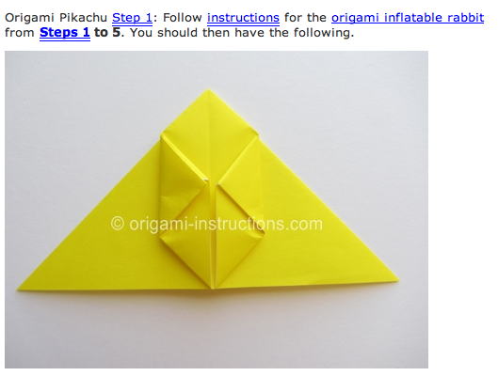
From www.origami-instructions.com

Slide 19
To make a Pikachu you have to:
Make the first 5 steps of the inflatable rabbit
To make the Inflatable Rabbit you have to:
Make the Waterbomb Base
Why so many levels?
Why not repeat instructions?

Slide 20
Advantages of Combining Algorithms
Common patterns are recognized
Consistency
No need to repeat – less work
Reusability
Easier to change
Notes:
Allow students to list advantages before showing any of these.

