Slide 1
Lavorare con gli insegnanti: esperienze del gruppo T4T - Teachers for Teachers -
G. Barbara Demo
Dipartimento di Informatica
Università di Torino
Gruppo di lavoro Informatica e scuola del GRIN (Associazione nazionale dei docenti e ricercatori di Informatica nelle università)

Slide 2
Introducendo la programmazione nelle scuole del primo ciclo (un tempo dette elementari e medie) bisogna tenere conto delle esperienze che vari insegnanti hanno giá condotte e quelle che vanno conducendo
Alcuni maestri hanno realizzato esperienze di grande interesse sin dalla fine degli anni ’80
Il gruppo di lavoro T4T Teachers for Teachers è nato per mescolare le esperienze di insegnanti e ricercatori di informatica quando si fa viva l’esigenza di una nuova presenza dell’informatica nelle scuole

Slide 3
inspiring the activities of our proposals suggested by T4T teachers:
Principi chiave
activities are learning environments, programming activities as well. This means that the activity contributes to the “overall growth of the child in its ethical, social and intellectual capabilities”*, from the beginning to the end of the activity development,
every action must have a specific educational goal and be integrated with the overall pedagogical and disciplinary contents of the grade it is proposed to,
particularly in the early years, programming must be conceived as one of the ``hundred'' languages children shall use to create and express themselves, as from Loris Malaguzzi of Reggio Emilia schools
* from National Indications for k-8 education

Slide 4
Our problems when deciding what has to be done:
our responsibility is finding a balance with the other topics already in k-8 education
respectful of the experience of good teachers and we have many!
also we want to respect Humanities in education

Slide 5
Respect the humanities in education as summarized in
Teach how?
“More and more often we treat education as if its primary goal should be to teach students to be economically productive rather than to think critically and to become informed and empathetic citizens”
Martha Nussbaum, Not for profit: why democracy needs the humanities. Princeton University Press (2010)

Slide 6
From T4T experience:
Working with teachers is inspiring: allows discovering what is important in a methodological and pedagogical perspective
Thus makes us follow directions of analysis of a sw tool to check its possibilities perhaps not so interesting from a digital perspective but facilitating a methodology
Attivitá del gruppo T4T all’indirizzo
http://orientamento.educ.di.unito.it/

Slide 7
Alessandro Rabbone with his pupils developed MicroWorlds activities such as those entitled:
“Let’s sing” (“Si canta”)
“The auger” (“La trivella”)
during the 2005–2006 project KidsIdeasActivities
(BambiniIdeeProgetti) whose final video can be seen at
http://win.rabbone.it/ irreMMjr/progetti.asp#

Slide 8
Presentato un lavoro alla Teachers’ ISSEP Conference, Lubiana, 2015
il gioco del robot
risoluzione di puzzles tipo Ligthbot
progetto e realizzazione di attivitá inventate dai ragazzi
progetti collettivi come Cappuccetto rosso

Slide 9
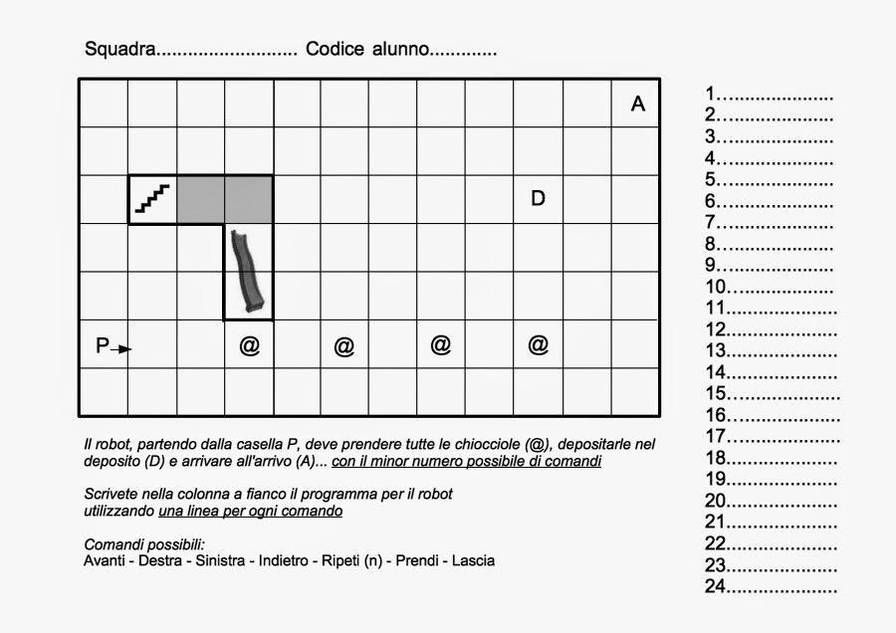
GIOCO DEL ROBOT: schede di gioco di S. Rabbone

Slide 10
Cappuccetto rosso classe 4 C

